Slide 1
Mastering Data Frame Diff
Jinxuan Wu, Software Engineer at Two Sigma
Notes:
Template 1.2.2
(1/02/2021)
New logo!

Slide 2
Important Legal Information
This document is being distributed for informational and educational purposes only and is not an offer to sell or the solicitation of an offer to buy any securities or other instruments. The information contained herein is not intended to provide, and should not be relied upon for, investment advice. The views expressed herein are not necessarily the views of Two Sigma Investments, LP or any of its affiliates (collectively, “Two Sigma”). Such views reflect the assumptions of the author(s) of the document and are subject to change without notice. The document may employ data derived from third-party sources. No representation is made by Two Sigma as to the accuracy of such information and the use of such information in no way implies an endorsement of the source of such information or its validity.
The copyrights and/or trademarks in some of the images, logos or other material used herein may be owned by entities other than Two Sigma. If so, such copyrights and/or trademarks are most likely owned by the entity that created the material and are used purely for identification and comment as fair use under international copyright and/or trademark laws. Use of such image, copyright or trademark does not imply any association with such organization (or endorsement of such organization) by Two Sigma, nor vice versa.

Slide 3

About me
Data Engineering @ Two Sigma
Big data since 2015
PMC member for Apache Sedona
Huge fan of DuckDB

Slide 4
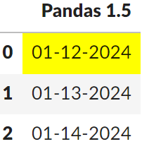
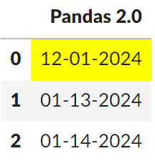
What’s going on?
Using pandas for parsing csv: pd.read_csv(f):
['01-12-2024', '01-13-2024', '01-14-2024’].
What
Why
Prepare
Use case and tools
Ending

Slide 5
Concept: Data Frame
Data Frame
2-dimensional data structure (rows and columns)
Examples:
Spread Sheet
Pandas Data Frame
BigQuery Table
What
Why
Prepare
Use case and tools
Ending

Slide 6
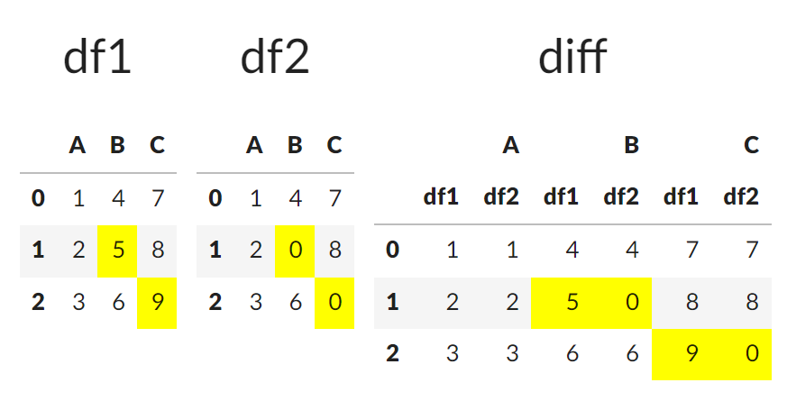
Concept: diff
What
Why
Prepare
Use case and tools
Ending
Notes:
A "diff" is a comparison between two data frame
A “diff” highlight changes between two data frame

Slide 7
Can we use a simple function?
For example: pandas.testing.assert_equals()
Notes:
No! Because

Slide 8

Challenges
Data Size, find needle in haystack
^{Schema complexity}
^{Nested structure (JSON value)}
^{What else?}
^{Floating-Point precision}
^{NaN vs Null vs ‘’ vs 0}
^{Does order matter?}
What
Why
Prepare
Use case and tools
Ending
Notes:
Data Volume: it find few rows that are missing from million rows.
Complex data structure: hundredfs of

Slide 9
Some misconceptions
Inexact match ≠ Unequal
2024-1-1 vs 2024-01-01
2024-01-01 00:00 vs 2024-01-01 00:00 UTC
Resource heavy operation ❌
What
Why
Prepare
Use case and tools
Ending

Slide 10
Data Frame diffing can help you with:
Data validation
Data quality
Explaining data discrepancies
What
Why
Prepare
Use case and tools
Ending
Notes:
There are two scenaros
You expect dataframe equals.
You don’t expect dataframe to be equal but you want to confirm the discrepancy is what you expected.

Slide 11
4 questions to think before diffing

Slide 12
Am I choosing a good storage system?
Database ✅
Parquet file format ✅
Text file (csv, tsv, xslx) ❌
What
Why
Prepare
Use case and tools
Ending

Slide 13
Do I understand this data?
Data frame shape
Key columns
Count key-groups
Schema
Column name
Column type
NULL values?
What
Why
Prepare
Use case and tools
Ending

Slide 14
Do I need to partition my data?
Pick partition key:
Date column
Category column
Reasonable partition size:
MB level for each partition
What
Why
Prepare
Use case and tools
Ending

Slide 15
Can I preprocess the data?
Align column name, data type
Standardize NULL values
Add trace information
file name
line number
etc.
Convert wide to narrow schema
If you have 1k+ columns
Pivot it on key columns
What
Why
Prepare
Use case and tools
Ending

Slide 16
Good preparation can significantly reduce complexity!

Slide 17
Use cases and tools

Slide 18
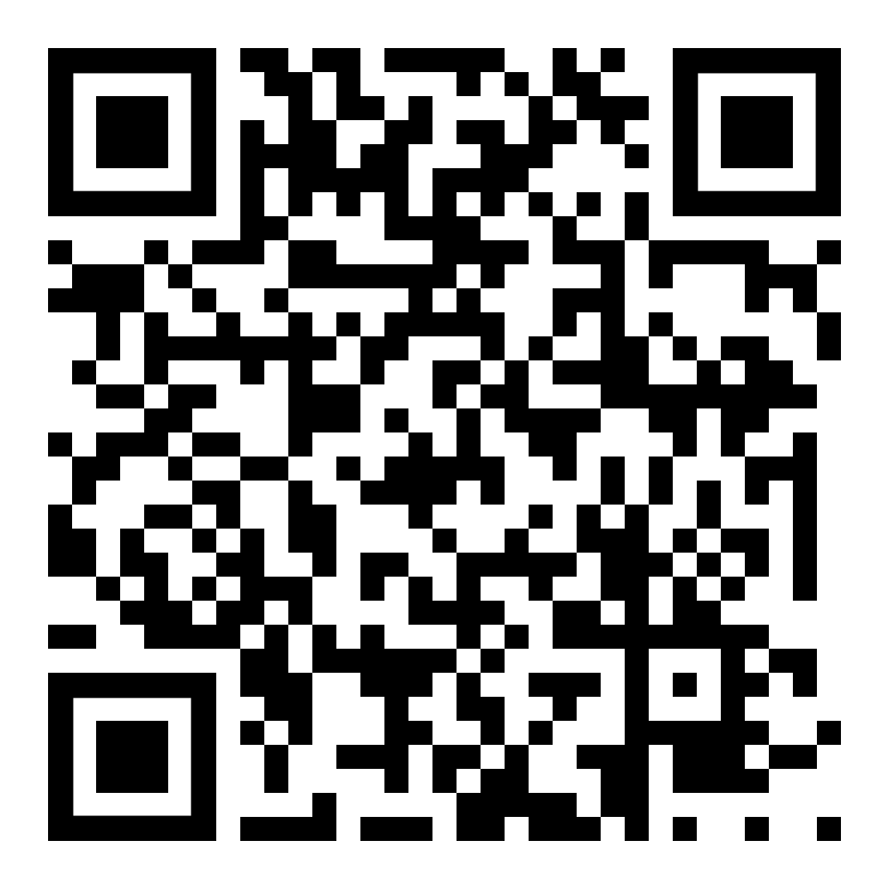
Source Code
https://jinxuan.github.io/datadiff-pydata/#/
What
Why
Prepare
Use case and tools
Ending

Slide 19
Check if data frame is equal

Slide 20
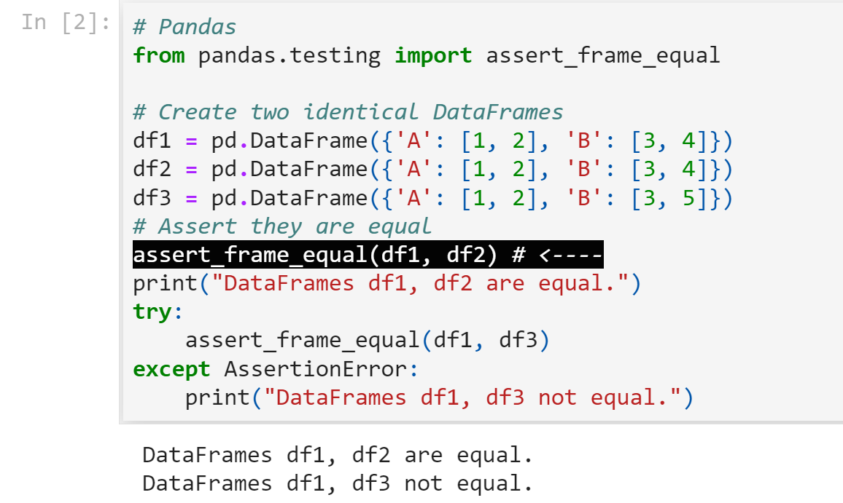
... using Pandas
What
Why
Prepare
Use case and tools
Ending

Slide 21
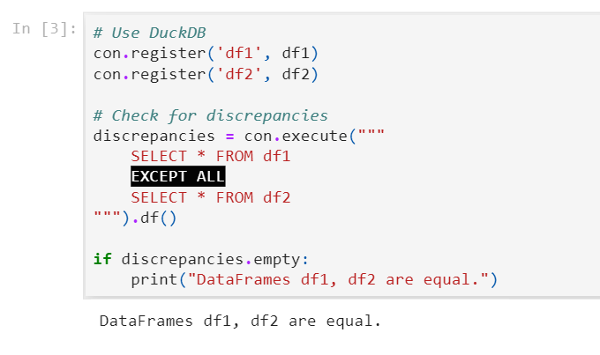
...using DuckDB
What
Why
Prepare
Use case and tools
Ending

Slide 22
2.
Find Discrepancies

Slide 23
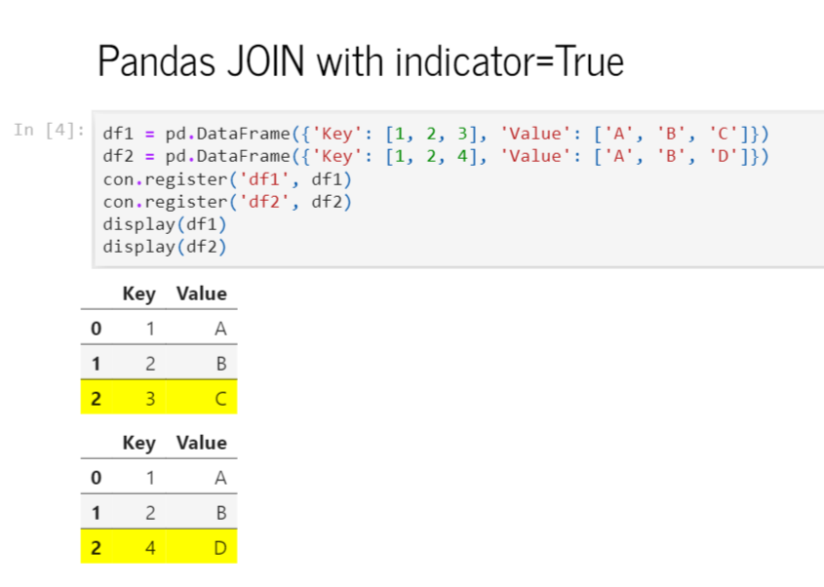
...using Pandas (input)
What
Why
Prepare
Use case and tools
Ending

Slide 24
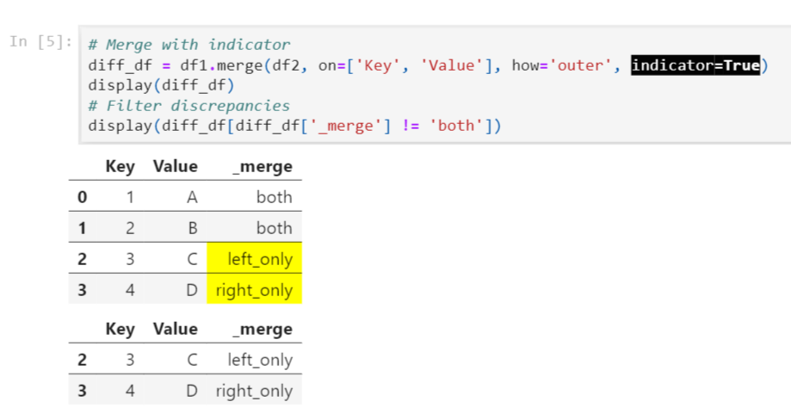
...Pandas (output)
What
Why
Prepare
Use case and tools
Ending

Slide 25
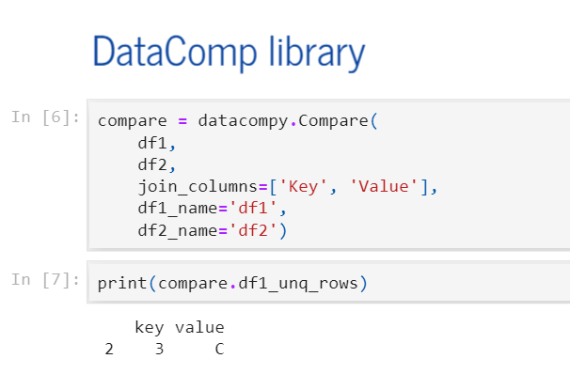
...using DataComPy, we can diff the discrepancy...
What
Why
Prepare
Use case and tools
Ending

Slide 26
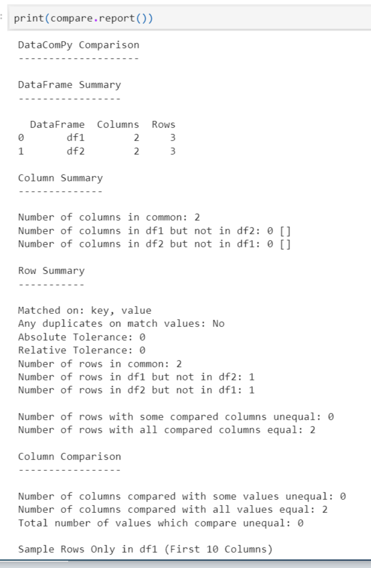
...or we can produce a DataComPy Report
What
Why
Prepare
Use case and tools
Ending

Slide 27
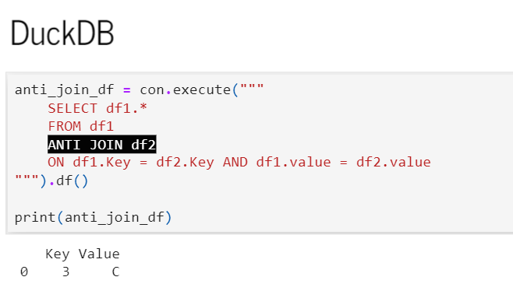
...using DuckDB
What
Why
Prepare
Use case and tools
Ending

Slide 28
Fuzzy Temporal Data Diff

Slide 29
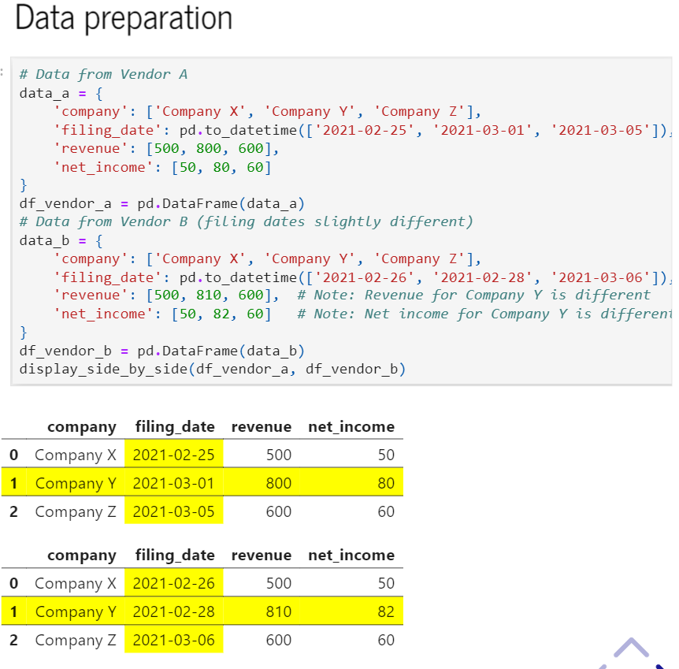
… using Pandas (input)
What
Why
Prepare
Use case and tools
Ending

Slide 30
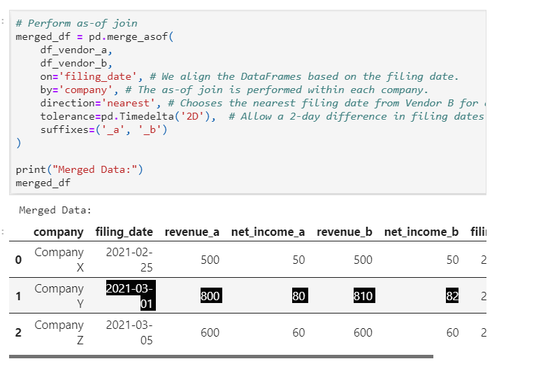
...Pandas (output)
What
Why
Prepare
Use case and tools
Ending

Slide 31
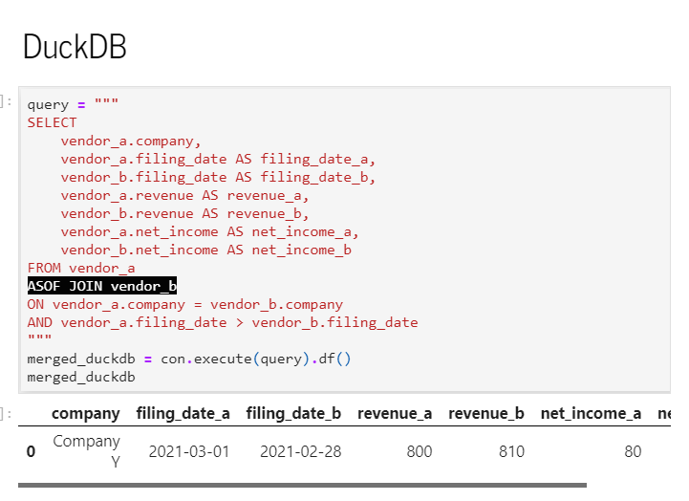
...using DuckDB
What
Why
Prepare
Use case and tools
Ending

Slide 32
Let's find that needle in the haystack!

Slide 33
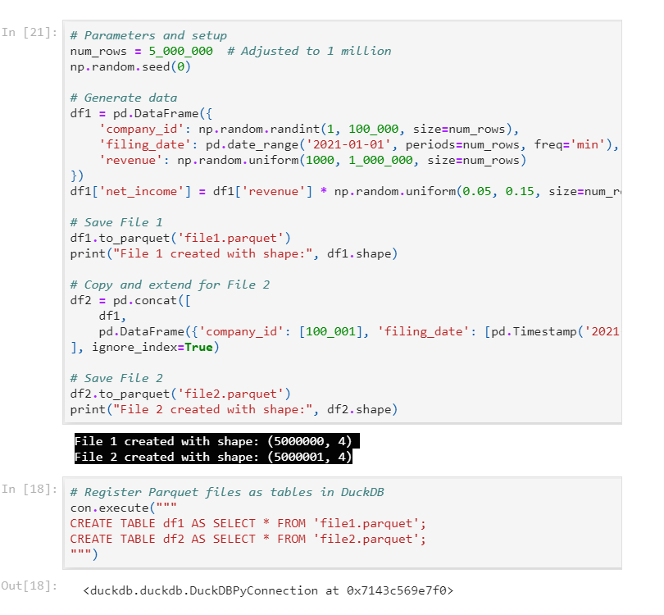
...input for both Pandas & DuckDB
What
Why
Prepare
Use case and tools
Ending

Slide 34
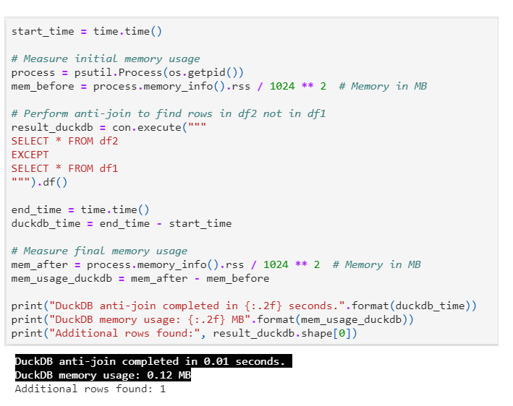
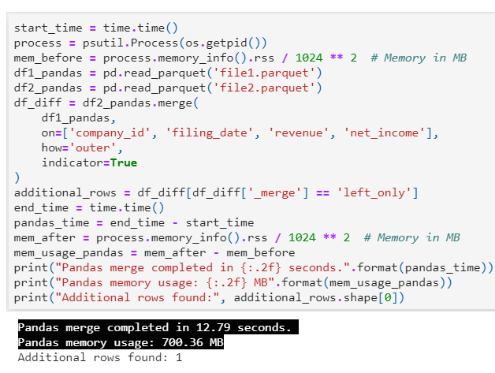
Performance
...using Pandas
...using DuckDB
What
Why
Prepare
Use case and tools
Ending

Slide 35
If diff failed with OOM
Repartition and parallel process
Use cloud data warehouse
Google BigQuery / Snowflake
What
Why
Prepare
Use case and tools
Ending

Slide 36
Takeaways

Slide 37
Data frame diffing
can be complicated​
What
Why
Prepare
Use case and tools
Ending

Slide 38
Prepare your data frame
What
Why
Prepare
Use case and tools
Ending

Slide 39
Remember the 3 use cases
is equal
Find discrepancy
Fuzzy temporal
What
Why
Prepare
Use case and tools
Ending

Slide 40
Resources can be found at <INSERT LINK HERE>
Pandas merge
Pandas merge_asof
Duckdb anti join
Duckdb asof join
What
Why
Prepare
Use case and tools
Ending

Slide 41
Questions?
https://www.linkedin.com/in/jinxuan-wu-6a683b80

Slide 42
Future Trends
Emerging Tools and Technologies
LLM to diff free-form text
‘NVIDIA CORP’ vs ‘NVDA’
Data storage Formats
Geo spatial, vector data
Saas company
Datafold
What
Why
Prepare
Use case and tools
Ending

Slide 43
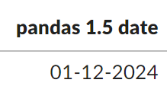
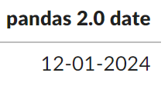
What’s going on?
pandas.read_csv return different date?
^{Input: ‘01-12-2024’}
^{Regression test}
^{Dataframe diffing}
Pandas 1.5 vs Pandas 2.0 parse date differently
https://pandas.pydata.org/docs/whatsnew/v2.0.0.html#datetimes-are-now-parsed-with-a-consistent-format
What
Why
Prepare
Use case and tools
Ending

